Slide 1
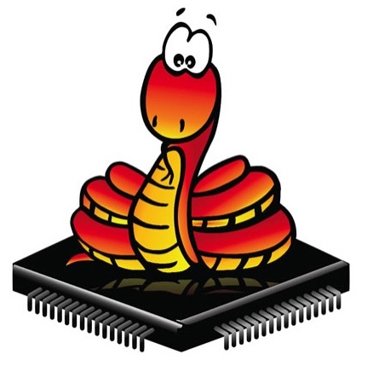
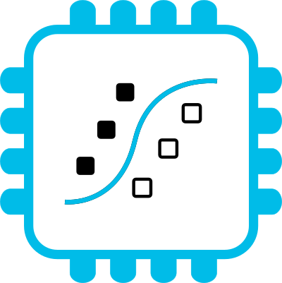

Bridging the TinyML language gap
with MicroPython and emlearn
https://github.com/emlearn/emlearn
Jon Nordby jononor@gmail.com
March 2025, Nuremberg

Slide 2
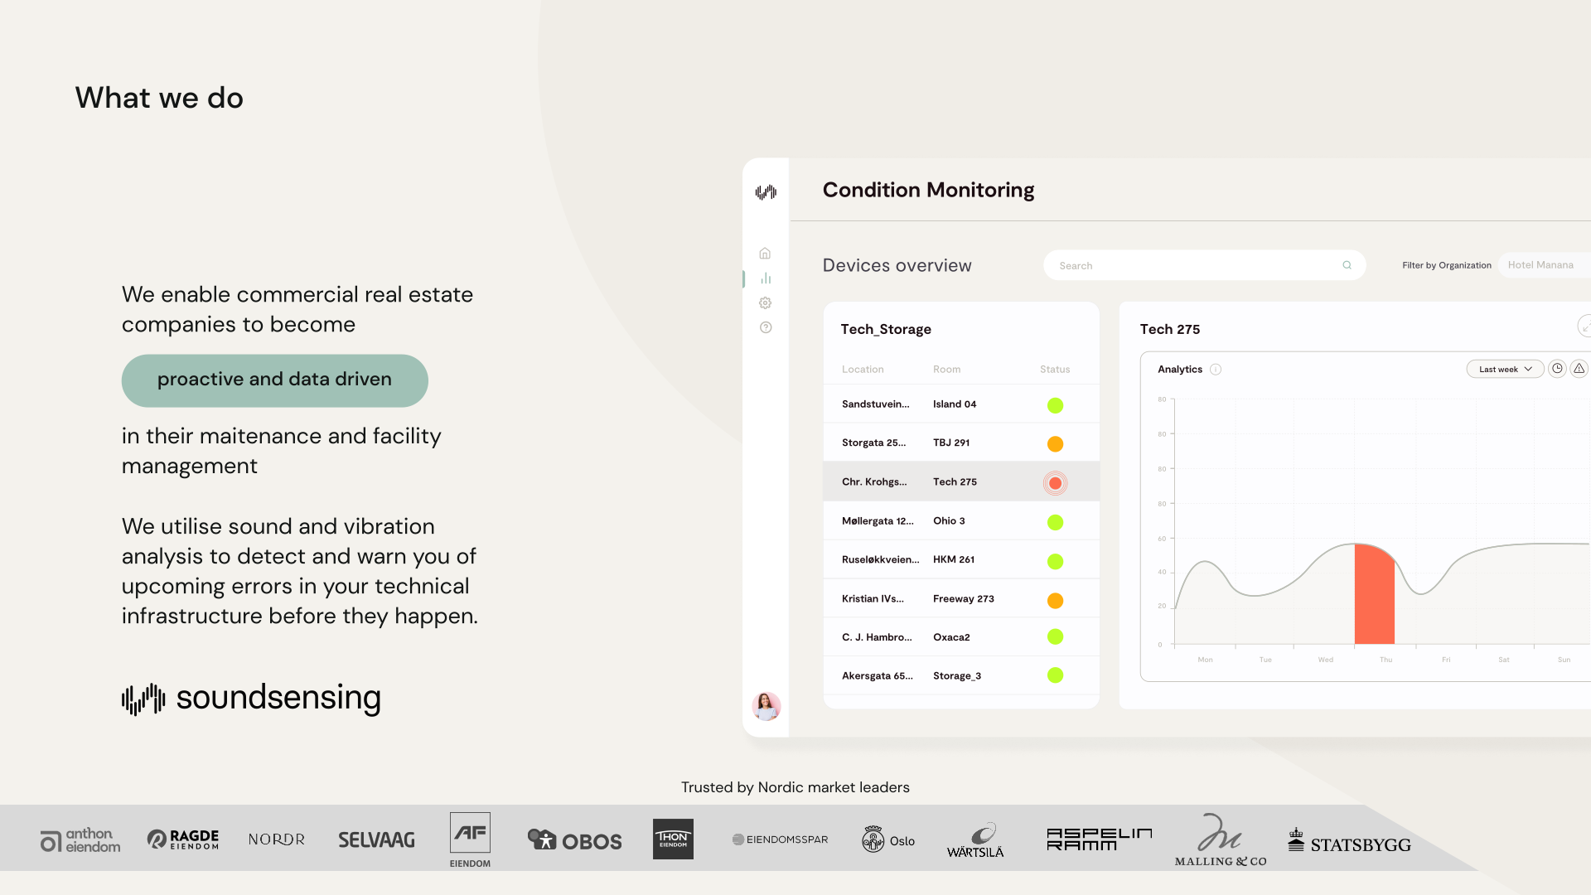


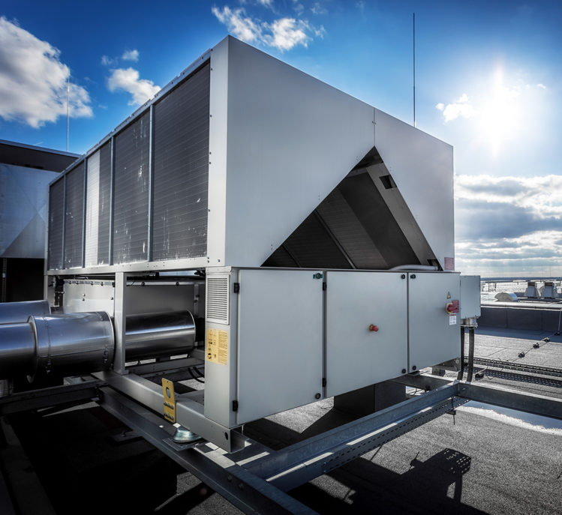
Notes:
Work as Head of Data Science at Soundsensing.
Soundsensing is a leading provider of predictive maintenance solutions for ventilation systems in buildings. So we work a lot with sensor data. And also use Python as much as we can for Data Science, IoT and backend tasks.

Slide 3
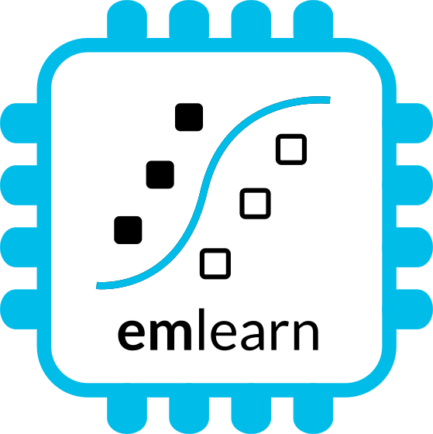
Outline / agenda
Brief introduction to TinyML
TinyML with emlearn
emlearn - overview, C library
emlearn + Zephyr RTOS
2. Bridging the TinyML language gap
MicroPython
emlearn-micropython
Notes:
As a brief structure of this presentation

Slide 4
TinyML overview

Slide 5
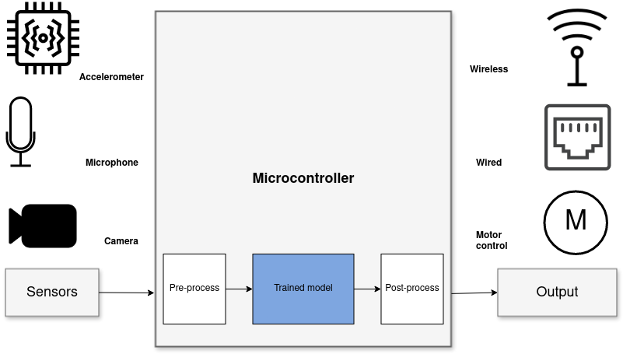
Sensor data analysis with Machine Learning
Benefits vs sending data to cloud
Stand-alone
Low latency
Power efficiency
Privacy
Low cost
1) Read sensors –> 2) Process data * –> 3) Transmit/act on data data * including Digital Signal Processing (DSP) and Machine Learning (ML)
Notes:
When it comes to Machine Learning on microcontrollers,
we are obviously not going to be running any Large Language Models or generative image models.
But one usecase where ML is incredibly useful is in analysing sensor data.
Sensors such as accelerometers, microphonones, radars, and cameras have gotten incredibly cheap and powerful.
But in order to get useful information out of these, the raw data must be processed.
Using Machine Learning, in combination with Digital Signal Processing, allows analyzing complex phenomena.
If this is done on the microcontroller, we get a range of benefits:
...
The component in blue is the Machine Learning model, and is typically trained ahead of time on a PC.

Slide 6
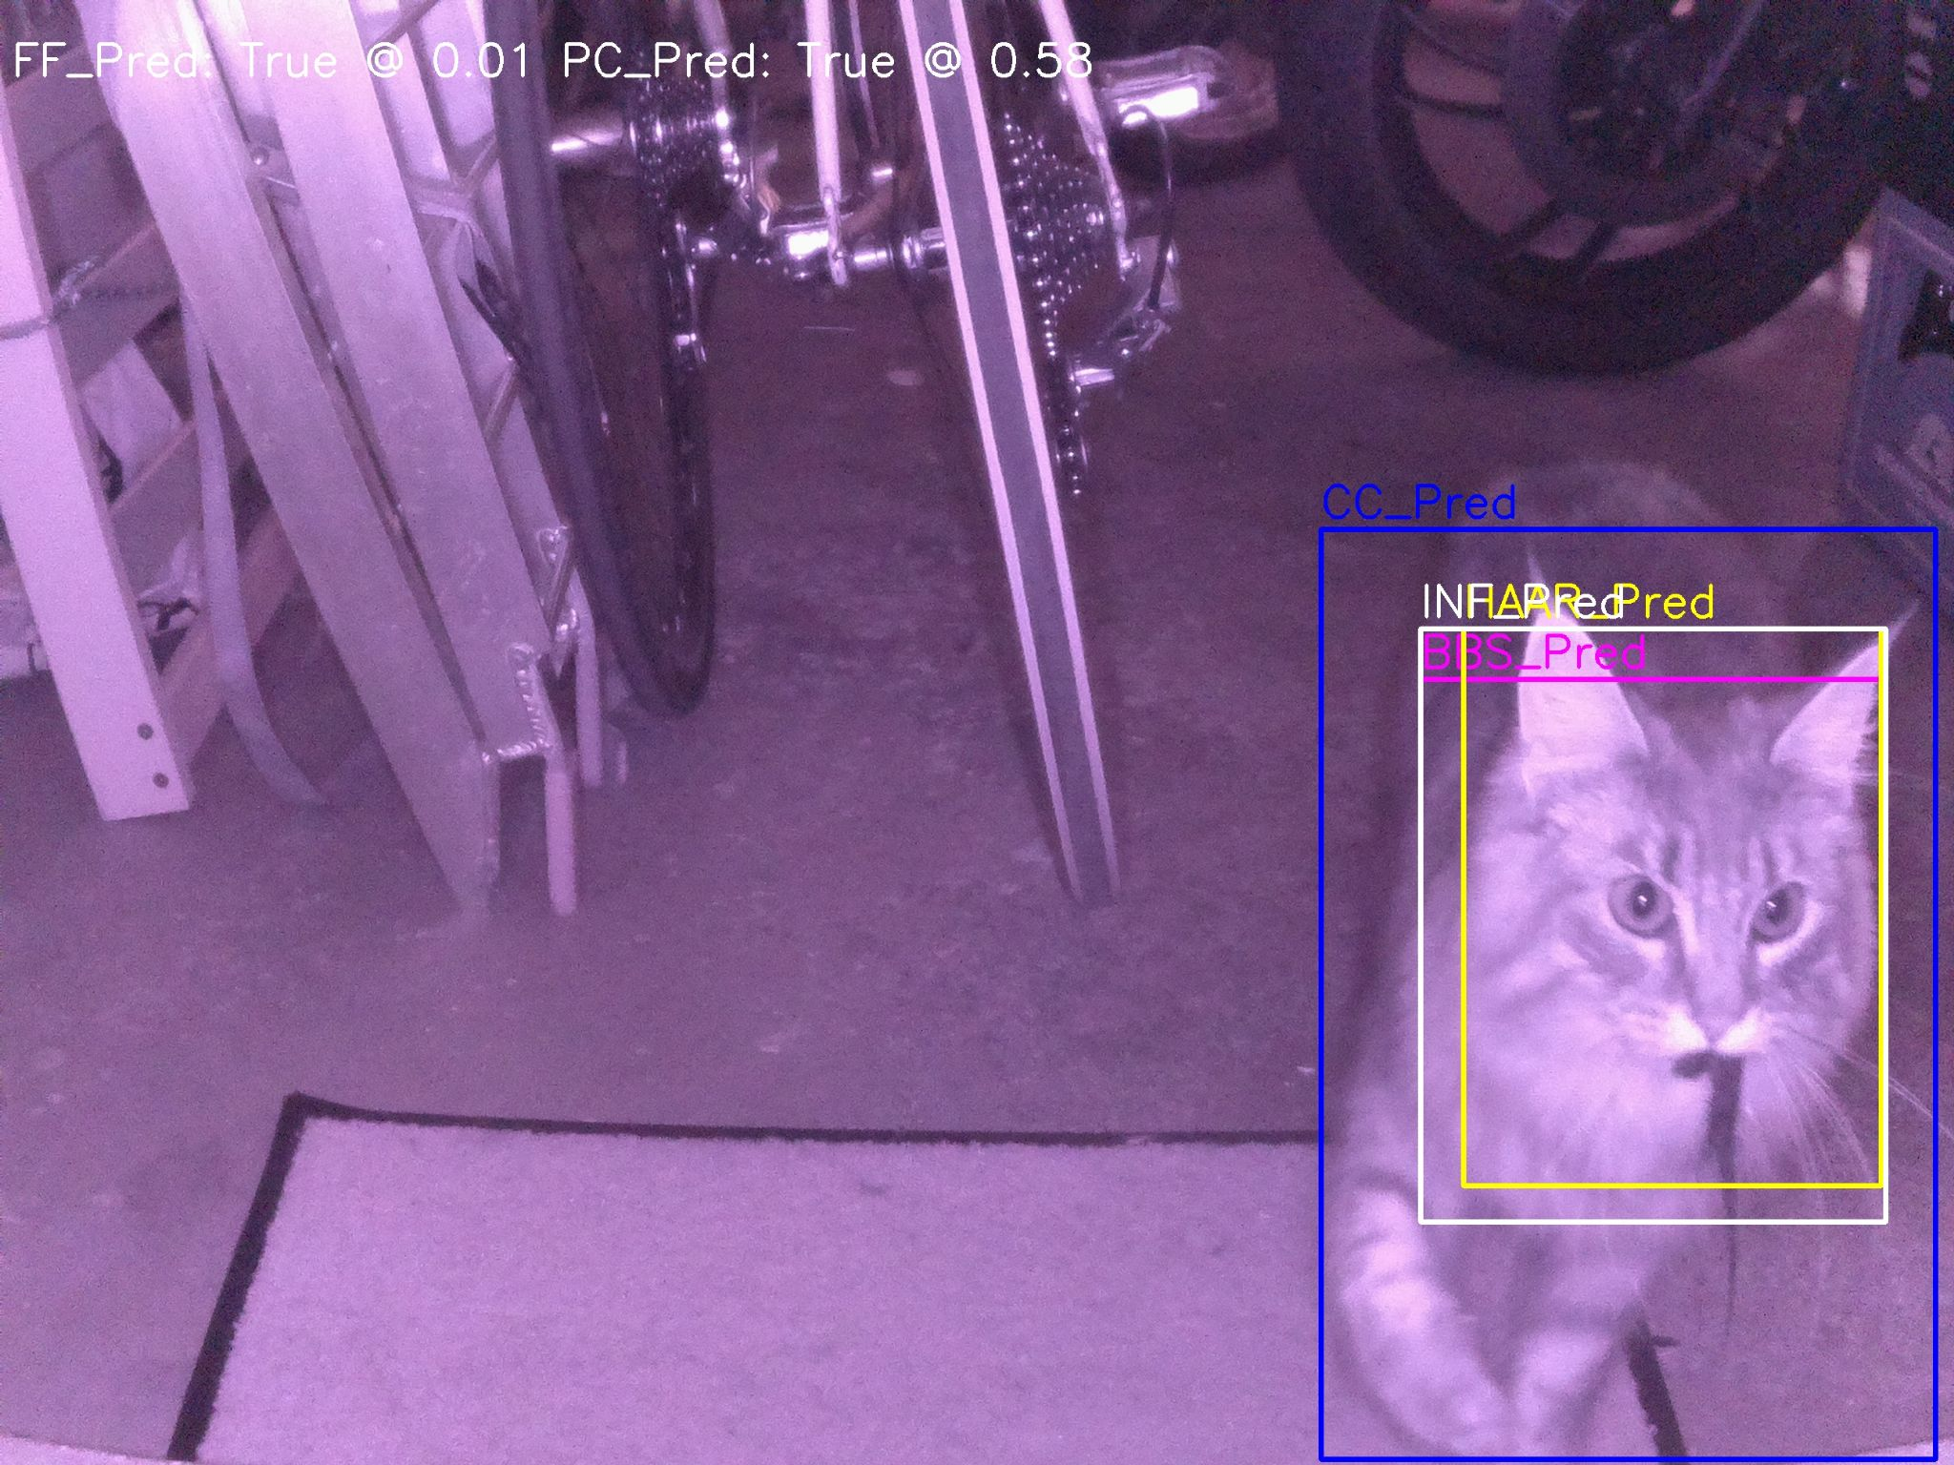
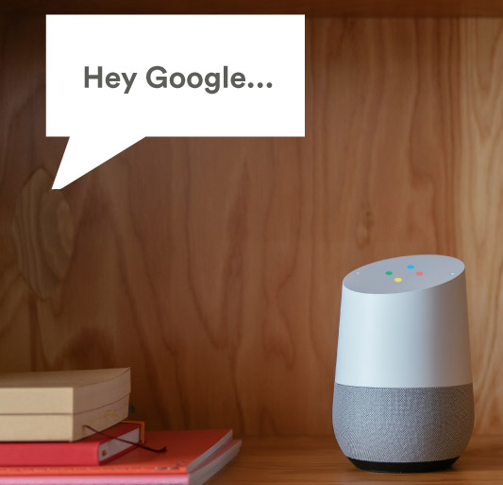
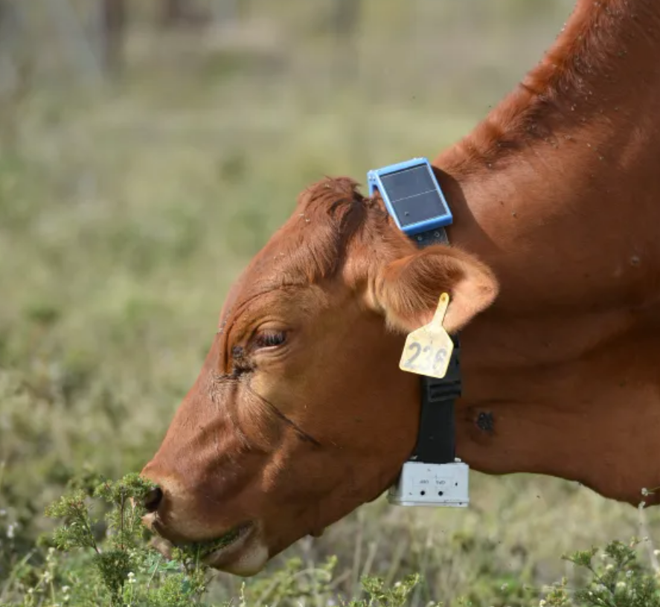
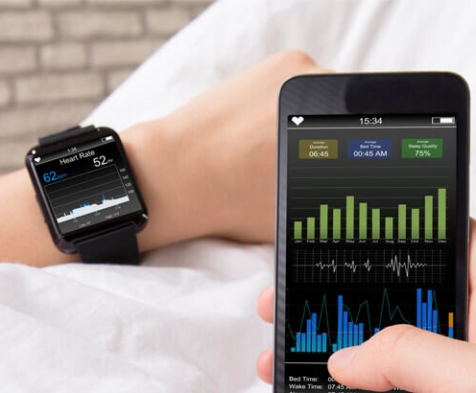
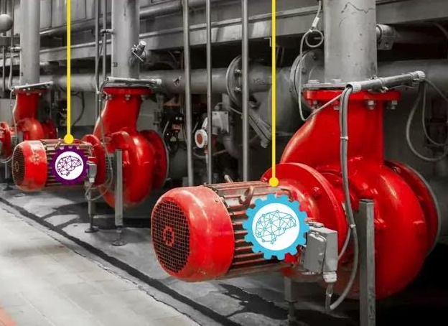
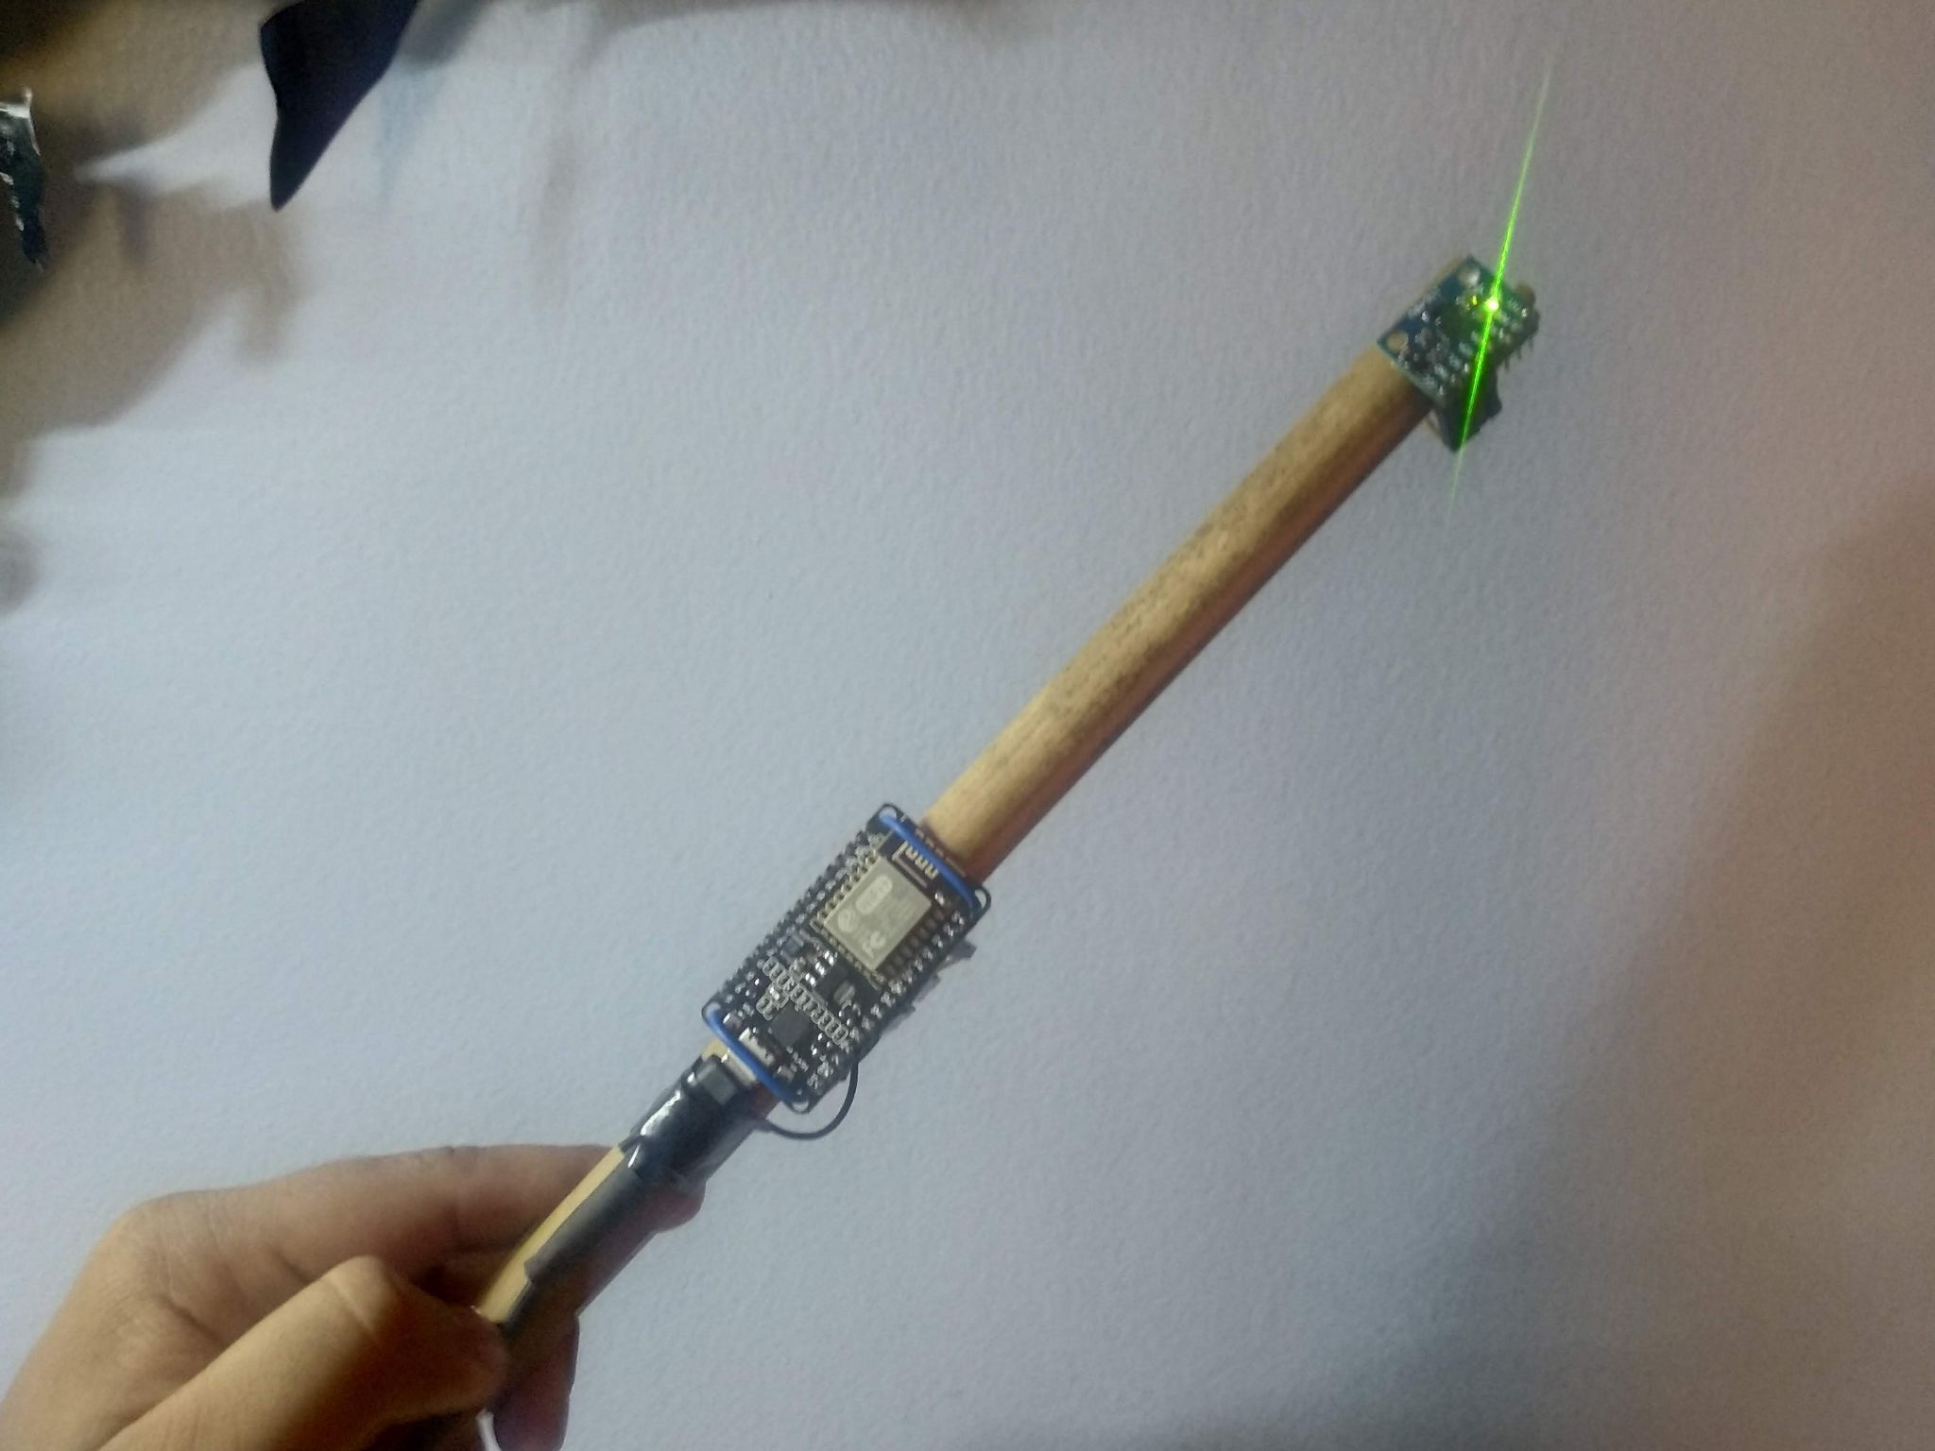
Applications
Consumer Tech
Industrial
Fun
Notes:
This is a huge amount of applications for this, in basically any field that uses electronics.
Keyword spotting / wakeword detection. “Alexa” Smartwatch. Sleep activity tracking Agriculture. Cattle activity tracking Condition monitoring of Machinery.
Or what about a cat doorbell that only lets in your cat, and only if it does not have a prey in its both. Magic wand.

Slide 7

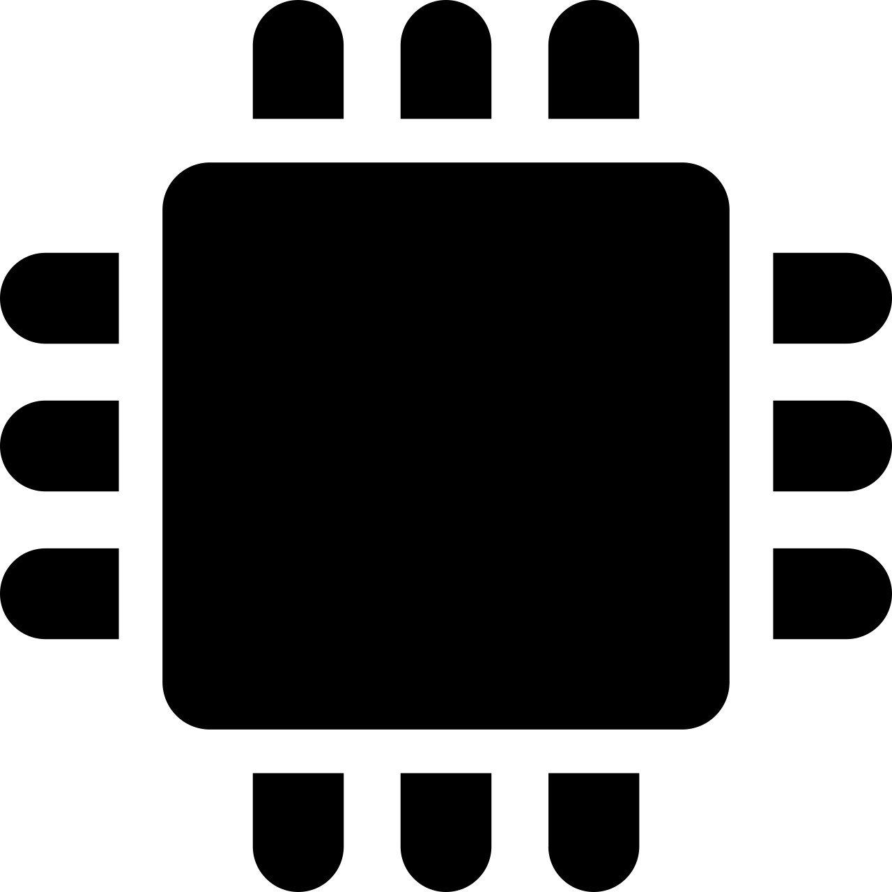





TinyML challenge: PC/host vs embedded/device pipeline
1) Train model on PC
2) Run on Device
Data
Sensor
RAM (min)
10 GB+
?
RAM (max): 1 MB
Pre-process
Pre-process
Model conversion tools
ML model
ML model
?
Embedded optimized pipeline
Deep-learning pipeline
Post-process
Post-process
Challenges
Very different constraints in the two environments
The two pipelines must be 100% compatible
Pre- and post-processing often application-specific, Turing complete
Different languages, tools, libraries, cultures
“Data Scientist land”
“Firmware Engineer land”

Slide 8
Strategy: Step-wise validation, code-sharing
1a) Train
on PC
1b) Pipeline test on PC
1c) Pipeline test on Device
2) Running on Device
Train
Sensor read
Validate
Validate
Validate
Pre-process
reuse*
Pre-process
Pre-process
Pre-process
ML model
convert
ML model
ML model
ML model
reuse*
Post-process
Post-process
Post-process
Post-process
Deep-learning pipeline
Embedded optimized pipeline
Embedded optimized pipeline
* Requirements: Pre- and -post processing must be portable between device and PC
Can be done in embedded C/C++ etc, or (MicroPython)

Slide 9
About emlearn
Started in 2018
Open-source (MIT)

Slide 10
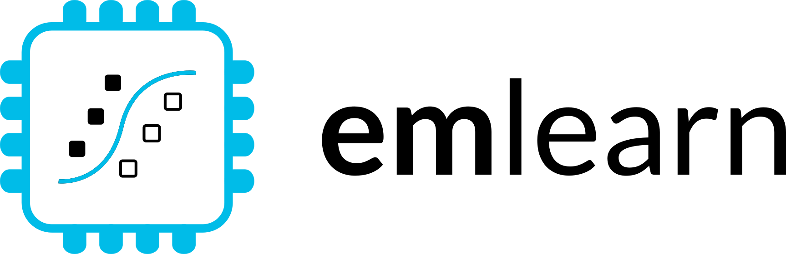




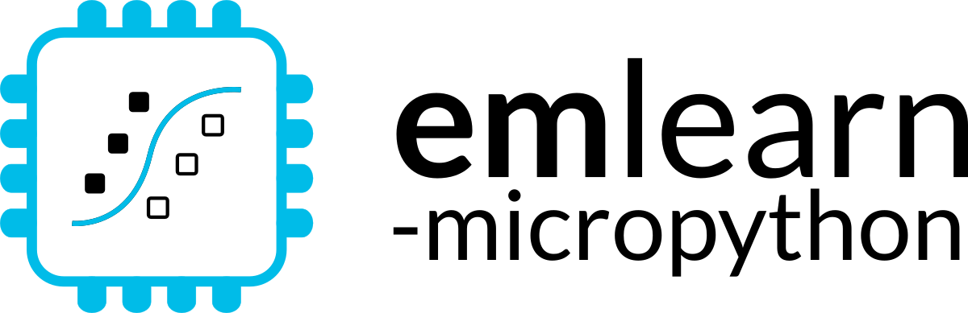



1. Train on PC
2. Deploy on device
$ pip install emlearn
Embedded Friendly
Portable C99 code
No dynamic allocations
Header-only
High test coverage
Integer/fixed-point math *
Small. 2 kB+ FLASH
Convenient training
Model creation in Python
Use standard libraries
scikit-learn
Keras
One-line to export to device
Verification tools included
Convenient & Efficient
Portable MicroPython
Single .mpy file
No dynamic allocations
High test coverage
Integer/fixed-point math *
Small. 2 kB+ FLASH
All code runs both on host/PC and device
Notes:
emlearn is an open-source software library that can be used to implement such projects.
It provides embedded friendly implementations of Machine Learning models.
It supports converting models trained in Python.
Can either use scikit-learn or Keras.
The code is portable and clean C99.
It can be used on even the smallest MCUs,
as it does not need FPU, and the code size is very small.

Slide 11
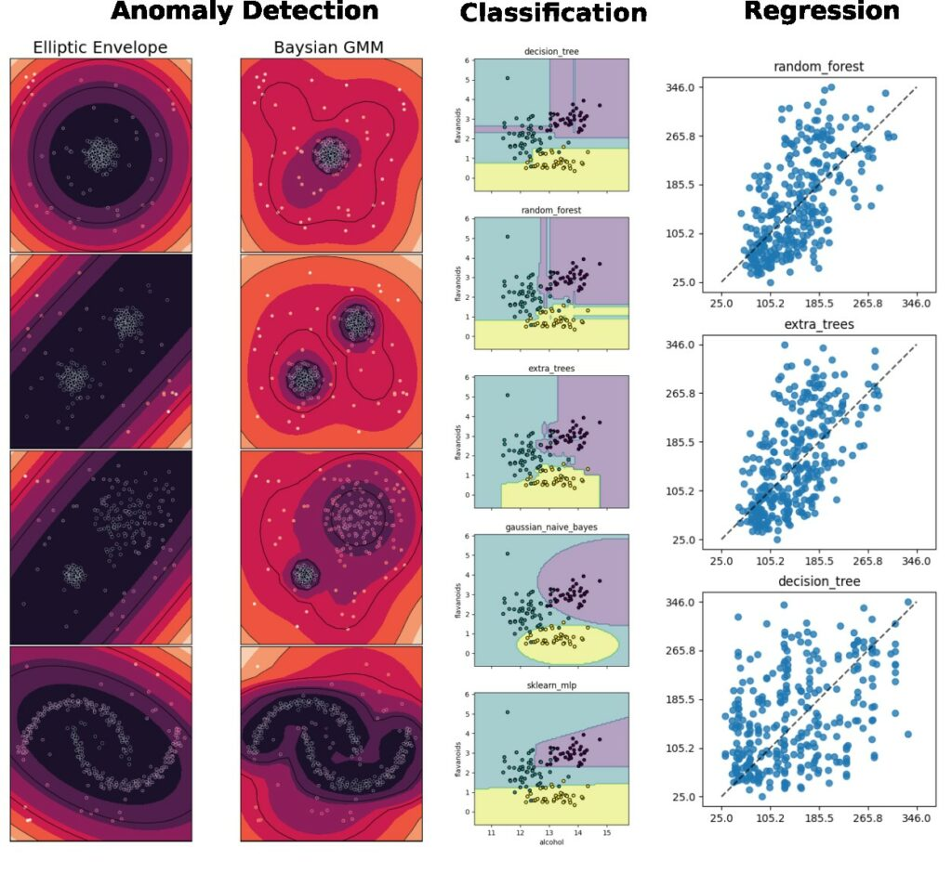
Supported tasks
Supports the most common tasks for embedded & sensor data use cases.
Classification
Regression
Anomaly Detection
Notes:
emlearn supports the three most common ML tasks:
classification, regression, anomaly detection.

Slide 12
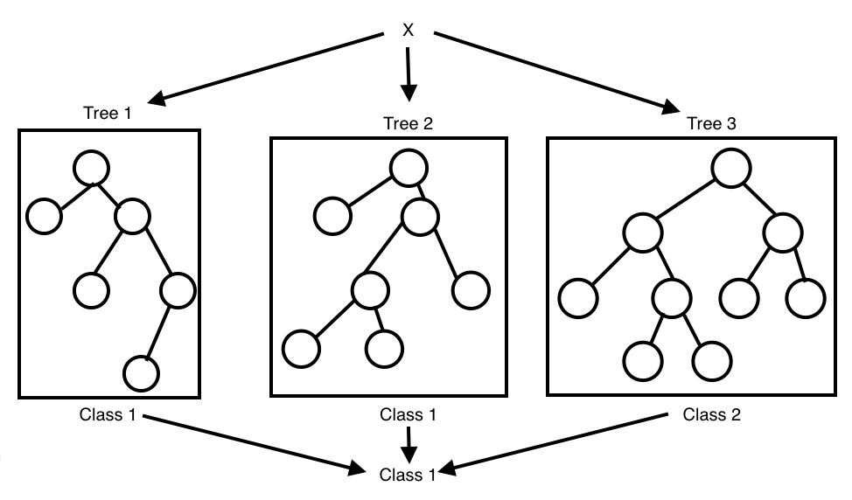
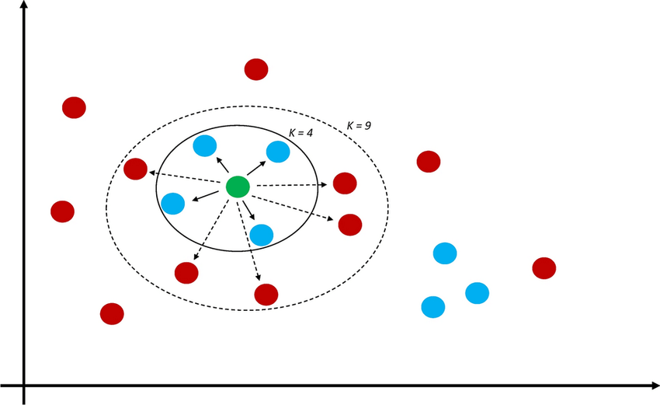
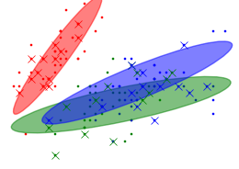
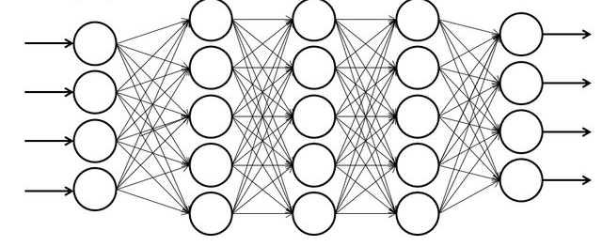
Supported models
Selection of simple & effective embedded-friendly models
Decision Trees (DT)
Random Forest (RF)
K Nearest Neighbors (KNN)
Gaussian Mixture Models (GMM)
Multi-Layer-Perceptron (MLP)
Convolutional Neural Network (CNN)
Notes:
Supports a selection of embedded friendly models:
….

Slide 13
Projects using emlearn
Many real-world uses across the globe
Referred in 40+ publications

Slide 14
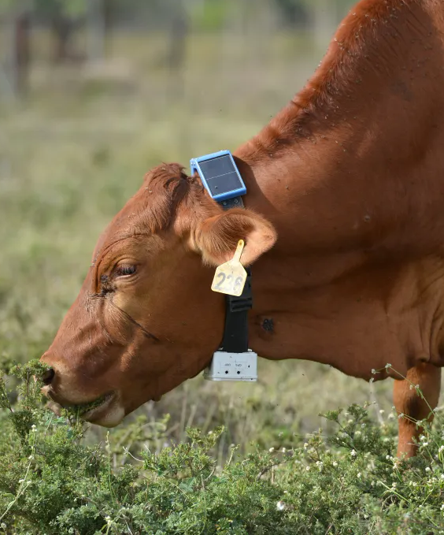
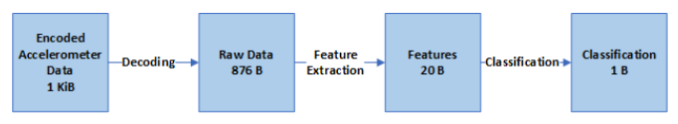

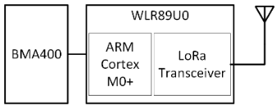
Health monitoring for cattle
Accelerometer data used to detect abnormal behavior. Can indicate health issues or other problems
Classified using a Decision Tree lying/walking/standing/grazing/ruminating Activity is transmitted using LoRaWAN
Running ML on-sensor: under 1 mW
50 times lower power than sending raw data
Power Efficient Wireless Sensor Node through Edge Intelligence
Abhishek Damle (2022)

Slide 15
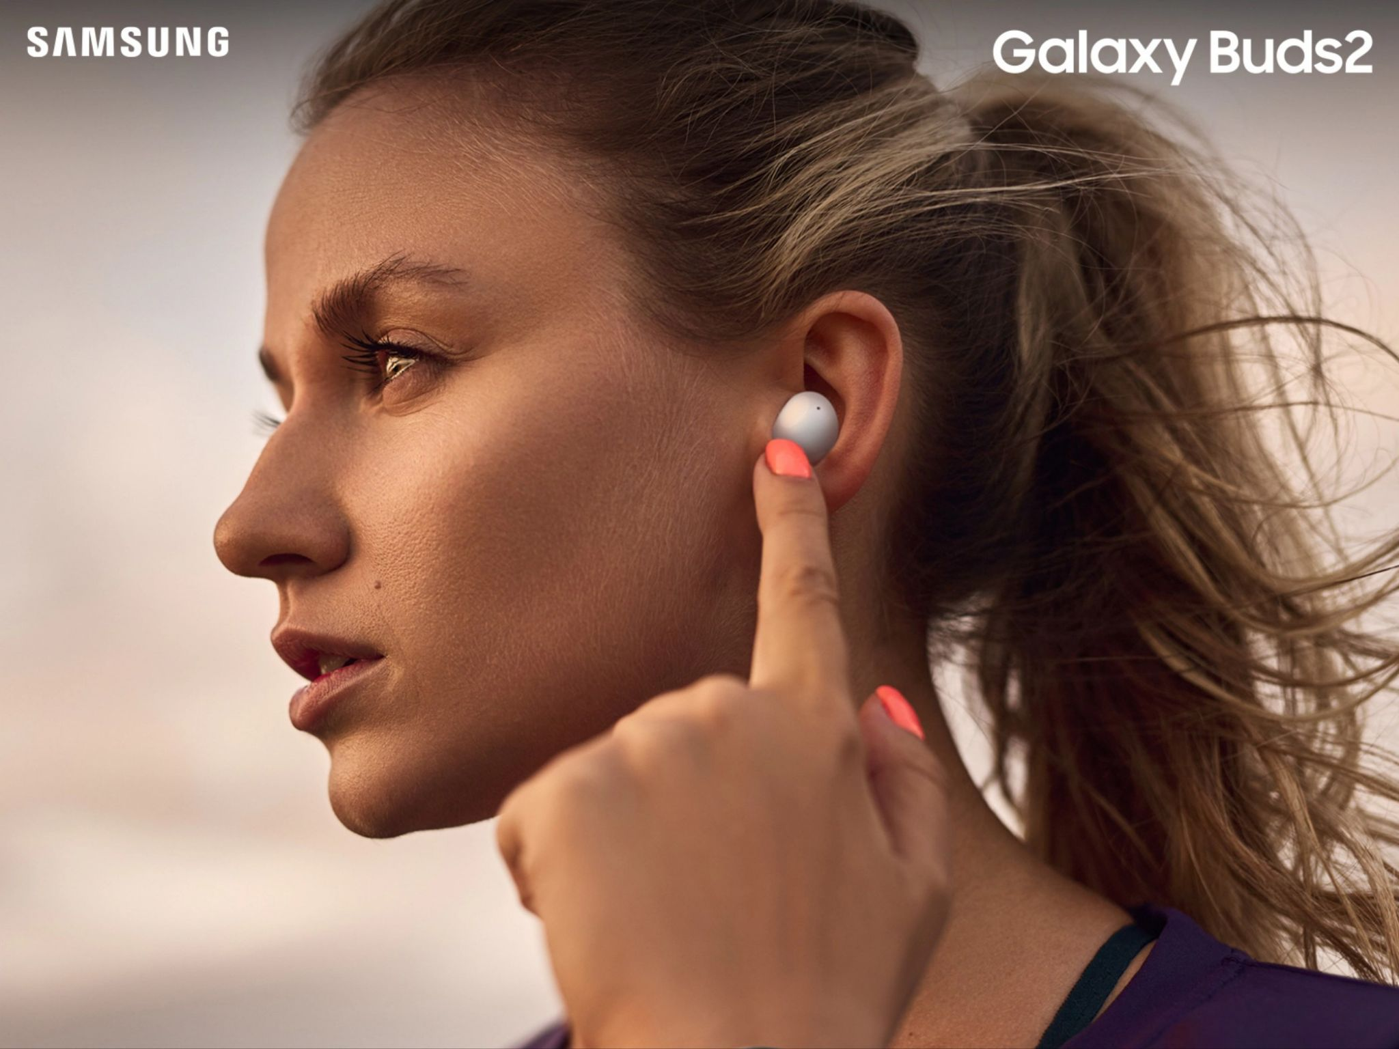
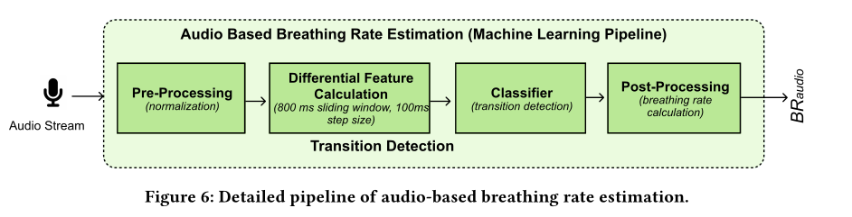
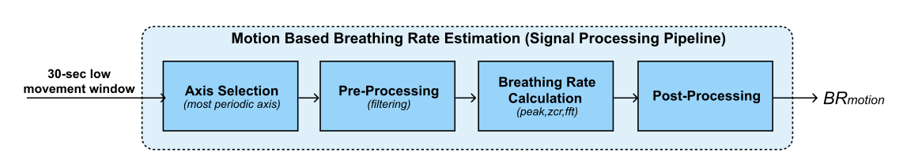
Health monitoring earable
Breathing rate is critical to monitor for persons with respiratory health problems.
Monitoring for every-day use, not just in clinical context. Using earable to replace specialized devices.
Random Forest classifier for audio.
Remote Breathing Rate Tracking in Stationary Position
Using the Motion and Acoustic Sensors of Earables
Tousif Ahmed et.al (2023)
Notes:
The project was started in 2018 by me.
And has been maintained by me since that time. With a couple of contributors here and there. Quite mature. Has been used for dozens of projects across the world.

Slide 16
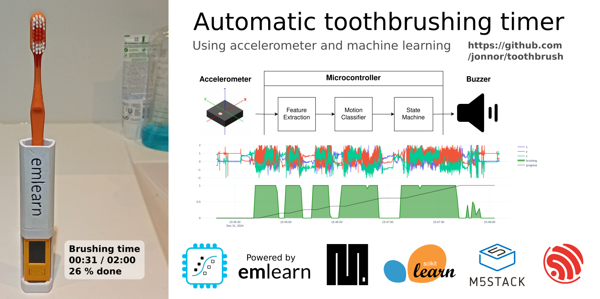
Automatic toothbrush timer
https://github.com/ jonnor/toothbrush/
Stock hardware: M5StickC PLUS 2 by M5Stack
~500 lines of MicroPython code
Collected and labeled data in ~1 hour
Data collection and training tools: https://github.com/emlearn/emlearn-micropython/tree/master/examples/har_trees

Slide 17
emlearn for C
Quick walkthrough

Slide 18
Train and export a model
Train using standard Python ML libraries.
from keras import …
model = Sequential([
Dense(16, input_dim=n_features, activation='relu'),
Dense(8, activation='relu'),
Dense(1, activation='sigmoid'),
])
model.compile(....)
model.fit(X_train, Y_train, epochs=1, batch_size=10)
keras neural network
from sklearn.neural_network import MLPClassifier
model = MLPClassifier(hidden_layer_sizes=(100,50,25))
model.fit(X_train, Y_train)
B) scikit-learn neural network
#include <eml_net.h>
static const float mynet_layer_0_biases[8] = { -0.015587f, -0.005395f, -0.010957f, 0.015883f ….
static const float mynet_layer_0_weights[24] = { -0.256981f, 0.041887f, 0.063659f, 0.011013f, …
static const float mynet_layer_1_biases[4] = { 0.001242f, 0.010440f, -0.005309f, -0.006540f };
static const float mynet_layer_1_weights[32] = { -0.577215f, -0.674633f, -0.376140f, 0.646900f, …
static float mynet_buf1[8];
static float mynet_buf2[8];
static const EmlNetLayer mynet_layers[2] = {
{ 8, 3, mynet_layer_0_weights, mynet_layer_0_biases, EmlNetActivationRelu },
{ 4, 8, mynet_layer_1_weights, mynet_layer_1_biases, EmlNetActivationSoftmax }
};
static EmlNet mynet = { 2, mynet_layers, mynet_buf1, mynet_buf2, 8 };
int32_t
mynet_predict(const float *features, int32_t n_features)
{
return eml_net_predict(&mynet, features, n_features);
}
………
2. Use emlearn.convert() and .save()
import emlearn
cmodel = emlearn.convert(model, method='inline')
cmodel.save(file=mynet_model.h', name='mynet')
Example of generated code
Notes:
Training a model is done using a standard framework like scikit-learn or keras.
You will need to already have a dataset collected and labeled for your task.
There is nothing emlearn specific at this point
- although you should use a model small enough to fit on your target device.
We also provide some tools for checking this.
Once you have a trained model, you are ready to deploy it to the device.

Slide 19
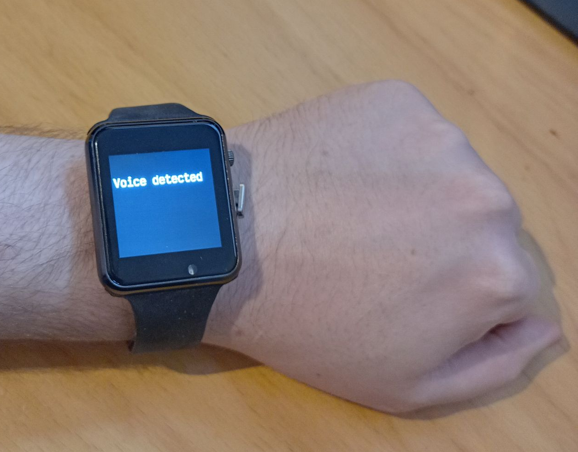
Using the C code
3. #include and call predict()
// Include the generated model code
#include "mynet_model.h"
// index for the class we are detecting
#define MYNET_VOICE 1
// Buffers for input data
#define N_FEATURES 6
float features[N_FEATURES];
#define DATA_LENGTH 128
int16_t sensor_data[DATA_LENGTH];
// Get data and pre-process it
read_microphone(sensor_data, DATA_LENGTH);
preprocess_data(sensor_data, features);
// Run the model
out = mynet_predict(features, N_FEATURES);
// Do something with results
if (out == MYNET_VOICE) {
set_display("voice detected");
} else {
set_display("");
}
setup
loop
Notes:
To use the code, include the generated header file.
Pass the data to the predict() call of the model.
The output can the be used to trigger relevant actions,
such as controlling motors, logging event that occur,
or sent an external system.
In this example, we just show the model output on a display.

Slide 20
emlearn on Zephyr

Slide 21
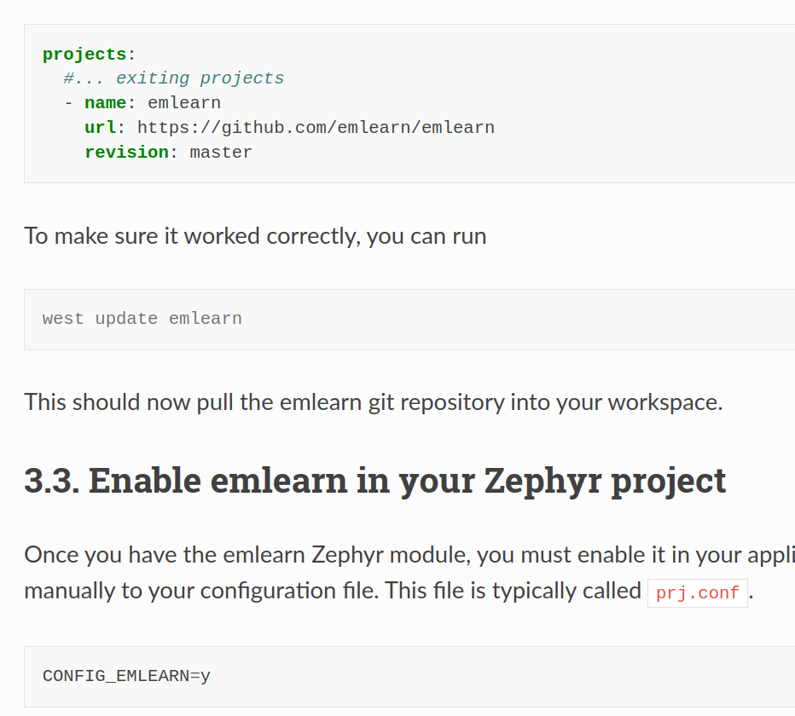
emlearn module for Zephyr
Add project to west.yml
Enable in your project
Use in your code #include <eml_net.h>
First class support since February 2024
https://emlearn.readthedocs.io /en/latest/ getting_started_zephyr.html
Notes:
STM32, Nordic NRF5x, ESP32, RP2040

Slide 22
Zephyr sensor data APIs
Unified hardware API across all platforms
Large amount of drivers included out-of-the-box
Examples
IMU (accelerometer/gyro) | Sensors API | https://docs.zephyrproject.org/latest/hardware/peripherals/sensor/index.html
Audio | Digital mic (DMIC) Digital Audio Interface (DAI) | https://docs.zephyrproject.org/latest/hardware/peripherals/audio/dmic.html
Images (camera) | Video API | https://docs.zephyrproject.org/latest/hardware/peripherals/video.html
Notes:
STM32, Nordic NRF5x, ESP32, RP2040

Slide 23
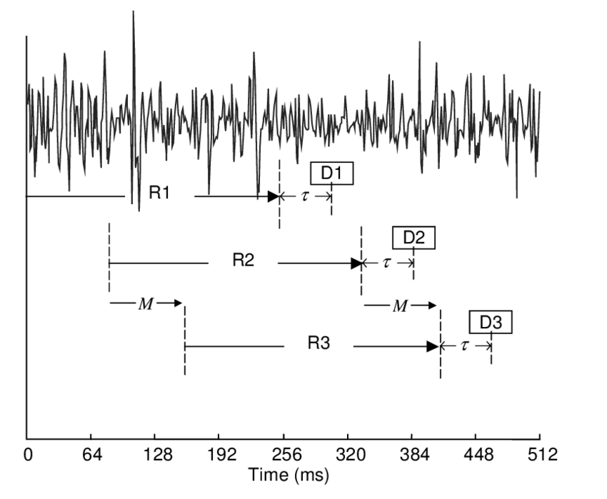
ML on streams: Continuous classification
The sensor data stream is sliced into overlapping windows.
Each window processed independently
Preprocess
Model
Raw sensor data
Features
Class
[ x1 y1 z1 x2 y2 z2
…. ]
[ 42, 4002, … , 329 ]
“Jumping Jacks”
Notes:
The sensor data steam is conceptually infinite
The Machine Learning models on the other hand must have finite and fixed-length inputs
This is done by splitting the stream at fixed intervals of time. Into windows
Usually with some overlap. So model gets multiple chances at predicting the same phenomena

Slide 24
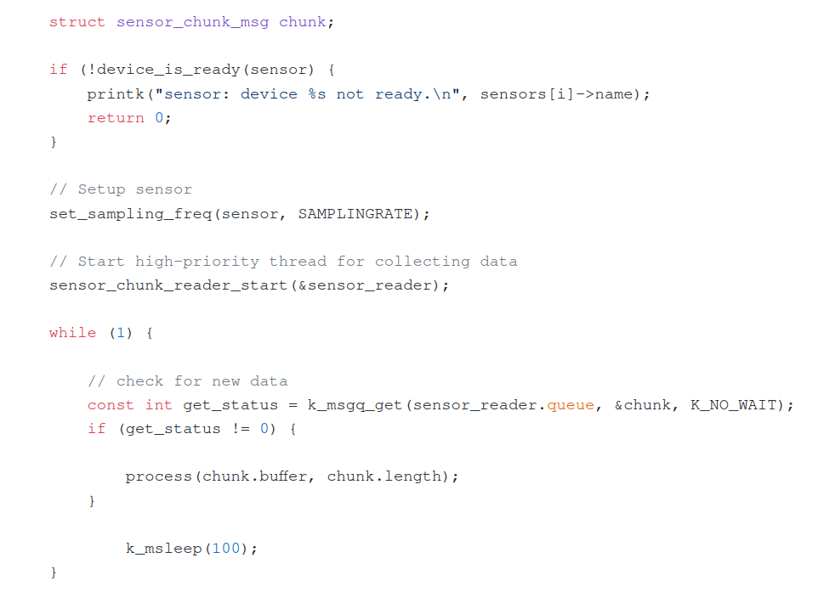
Chunked sensor reader for Zephyr
Work-in-progress Practical examples using sensor data for Zephyr https://github.com/emlearn/emlearn/issues/108
Dedicated thread handling time-sensitive fetching
Queue with complete chunks of data Allows application to process at convenient time
Notes:
The sensor data steam is conceptually infinite
The Machine Learning models on the other hand must have finite and fixed-length inputs
This is done by splitting the stream at fixed intervals of time. Into windows
Usually with some overlap. So model gets multiple chances at predicting the same phenomena

Slide 25
Bridging the TinyML language gap

Slide 26
TinyML challenge: PC/host vs embedded/device pipeline
1) Train model on PC
2) Run on Device
Data
Sensor
RAM (min)
10 GB+
?
RAM (max): 1 MB
Pre-process
Pre-process
Model conversion tools
ML model
ML model
?
Embedded optimized pipeline
Deep-learning pipeline
Post-process
Post-process
Challenges
Very different constraints in the two environments
The two pipelines must be 100% compatible
Pre- and post-processing often application-specific, Turing complete
Different languages, tools, libraries, cultures
“Data Scientist land”
“Firmware Engineer land”

Slide 27
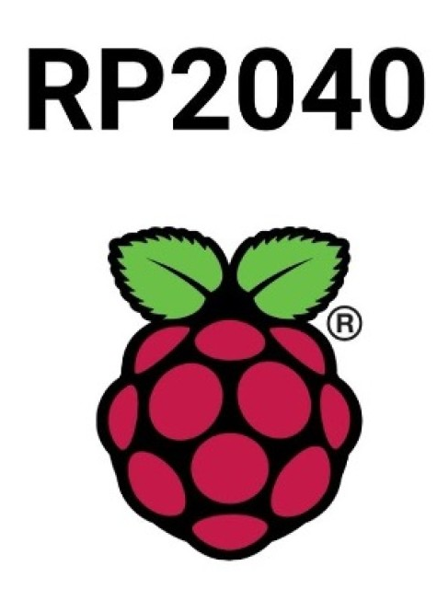
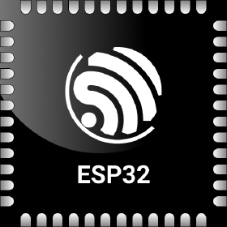
MicroPython - Introduction
Implements a subset of Python 3.x
For devices with 16 kB+ RAM
Supports 8+ microcontroller families
As compatible with CPython as possible, within constraints. No CFFI or C module compatibility! TLDR: Small .py scripts will mostly work with minor mods But not standard PyData stack
“mip” package manager Can load C modules at runtime!
More info: https://micropython.org
Notes:
STM32, Nordic NRF5x, ESP32, RP2040

Slide 28
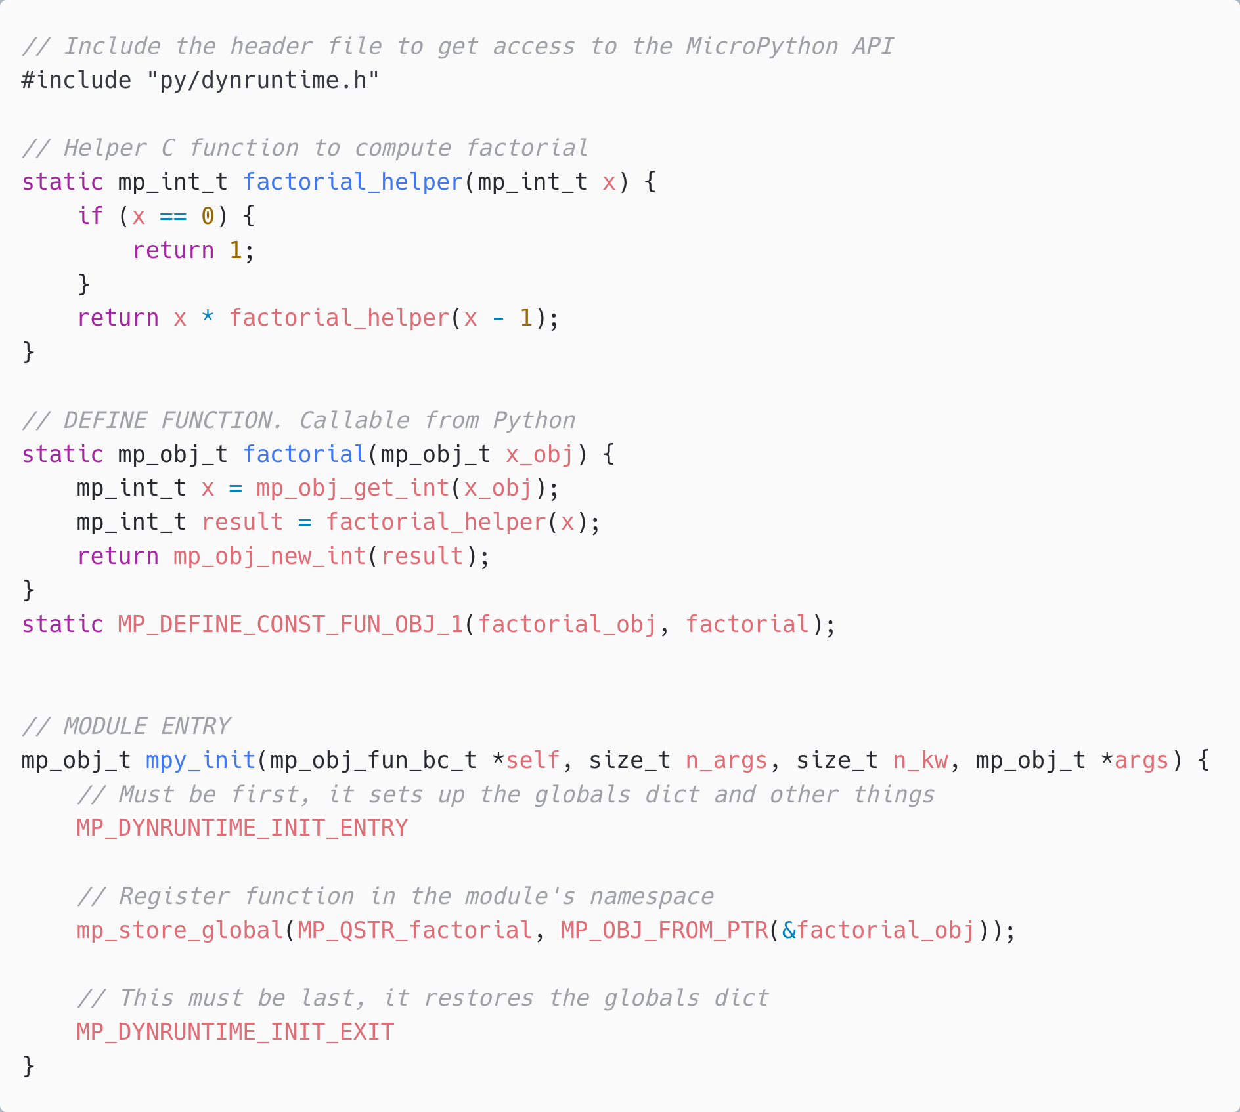
C modules *
Defines a Python module with API. functions/classes et.c.
Implemented by users, libraries, or be part of MicroPython core.
Can be portable or hardware/platform specific
* Or other language which compiles to C, or exposes C API https://github.com/ vshymanskyy/wasm2mpy C++, Rust, Zig, TinyGo, TypeScript

Slide 29
Native module (.mpy) VS External C module
 | Native module | External C module
Installable at runtime | Yes, as .mpy file | No. Must be included in firmware image
Requires SDK/toolchain | No (only to build) | Yes
Code executes from | RAM | FLASH
Limitations | No libc / libm linked * No static BSS * | None
Maturity | Low * | Excellent
Documentation | https://docs.micropython.org/ en/latest/develop/natmod.html | https://docs.micropython.org/ en/latest/develop/cmodules.html
* Improved greatly in upcoming MicroPython (1.25+). Contributions by Volodymyr Shymanskyy, Alessandro Gatti, Damien George, and others

Slide 30
MicroPython Data Science ecosystem
CPython
MicroPython
Tensorflow
scikit-learn
emlearn-micropython
OpenCV
OpenMV
https://openmv.io/
scipy
ulab
numpy
https://github.com/v923z/micropython-ulab
Libraries existing that implement a lot of embedded-relevant functionality from PyData stack.

Slide 31
emlearn for MicroPython
Python is the lingua franca for Machine Learning How can we enable people to build TinyML solution also using Python?

Slide 32
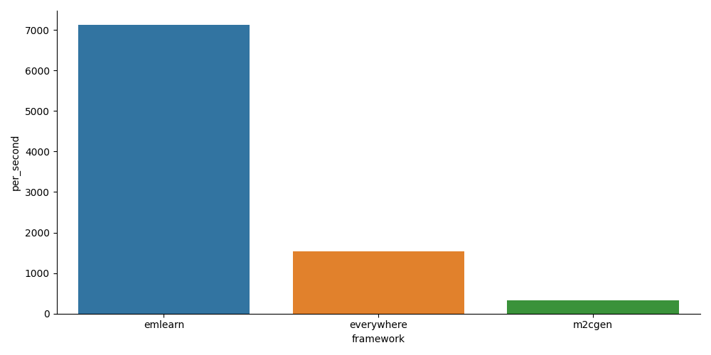
MicroPython library for emlearn
Combine the convenience, familiarity and productivity of Python - with the speed of C
Modules installable at runtime (.mpy)
5x - 20x faster than plain Python
emlearn_iir Infinite Impulse Response filters emlearn_trees Random Forest emlearn_fft Fast Fourier Transform emlearn_cnn Convolutional Neural Networks Image classification+ emlearn_neighbors K-nearest Neighbors On-device learning
https://github.com/emlearn/emlearn-micropython/

Slide 33
Install & Export model
import emlearn
estimator = train_model()
converted = emlearn.convert(estimator)
converted.save(name='gesture', format=’csv’, file='gesture_model.csv')
Export model on PC
Copy model to device
mpremote fs cp gesture_model.csv :
Prebuilt binary No need to setup C toolchain and SDK
Copy library to device
mpremote mip install https://emlearn.github.io/...../xtensawin_6.2/emltrees.mpy

Slide 34
Load model & run
import emltrees
# Instantiate model. Capacity for trees, decision nodes, classes
model = emltrees.new(20, 200, 10)
# Load model "weights"
with open('gesture_model.csv') as f:
emltrees.load_model(model, f)
Load model on device
# Read sensor data
sensor.fifo_read(samples)
# Preprocess features
preprocessor.run(samples, features)
# Run model
out = model.predict(features)
Run inference

Slide 35
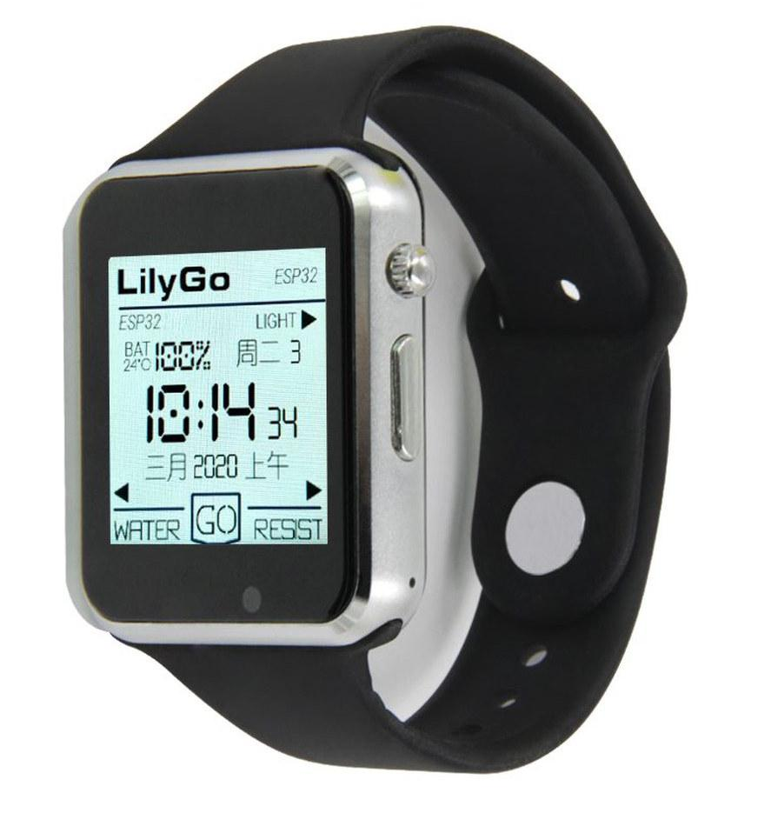
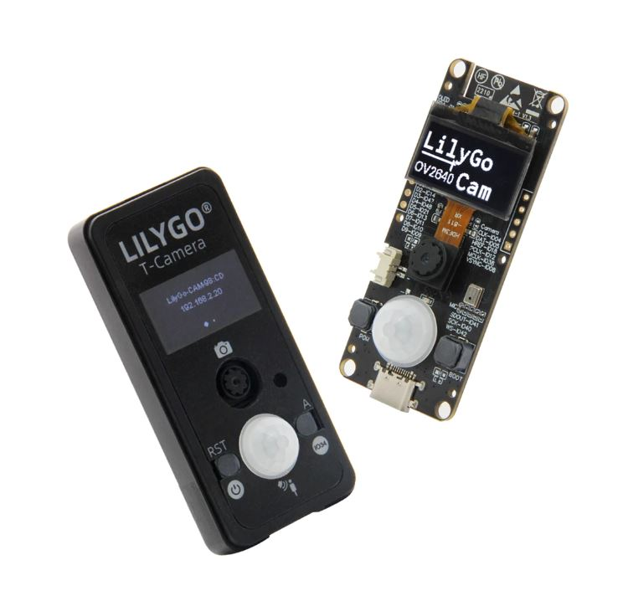

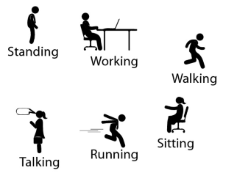
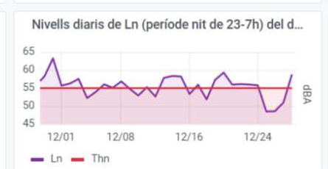
Activity tracker
Noise monitor
Image
Classifier
Accelerometer
Microphone
Camera
Examples at
https://github.com /emlearn/emlearn-micropython #examples
if is_MyCat(img): open_door()
Random Forest classifier emlearn_trees
Infinite Impulse Response filters emlearn_iir
Convolutional Neural Network emlearn_cnn

Slide 36
Outro

Slide 37
Summary 1/2
TinyML pipelines must be compatible between train/PC and deploy/device
Recommend using portable code with automated validation tests on both device and PC
Notes:
As a brief structure of this presentation

Slide 38
Summary 2/2
emlearn is an portable open-source project to help deploy ML pipelines to microcontrollers
emlearn supports both C and MicroPython
MicroPython with C modules enables writing TinyML applications primarily in Python
Notes:
As a brief structure of this presentation

Slide 39
More resources
Official documentation
https://emlearn-micropython.readthedocs.io https://emlearn.readthedocs.io
PyCon Berlin 2024: Machine Learning on microcontrollers using MicroPython and emlearn https://www.youtube.com/watch?v=S3GjLr0ZIE0 TinyML EMEA 2024: emlearn - scikit-learn for microcontrollers and embedded systems https://www.youtube.com/watch?v=LyO5k1VMdOQ
FOSDEM 2025: MicroPython - Python for microcontrollers and Embedded Linux https://fosdem.org/2025/schedule/event/fosdem-2025-4525-micropython-python-for-microcontrollers-and-embedded-linux/ FOSDEM 2025: Milliwatt sized Machine Learning on microcontrollers with emlearn https://fosdem.org/2025/schedule/event/fosdem-2025-4524-milliwatt-sized-machine-learning-on-microcontrollers-with-emlearn/
Notes:
Microcontroller is a small programmable chip.
That since the last 20 years provides the “brain” of basically any electronics device around us.
All the devices that you have in your home have 1 or more microcontrollers each.
A modern car has over 50 microcontrollers.
While they are mostly used for industrial application, they are increasingly accessible for hobbyists and semi-professionals. And today many of these devices can run Python! So in a way, you probably already know how to program them.

Slide 40
Bridging the TinyML language gap
with MicroPython and emlearn
https://github.com/emlearn/emlearn
Jon Nordby jononor@gmail.com
March 2025, Nuremberg

Slide 41
Bonus

Slide 42
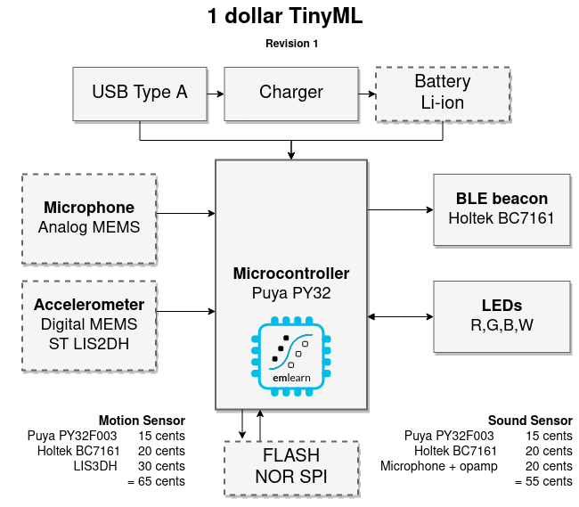
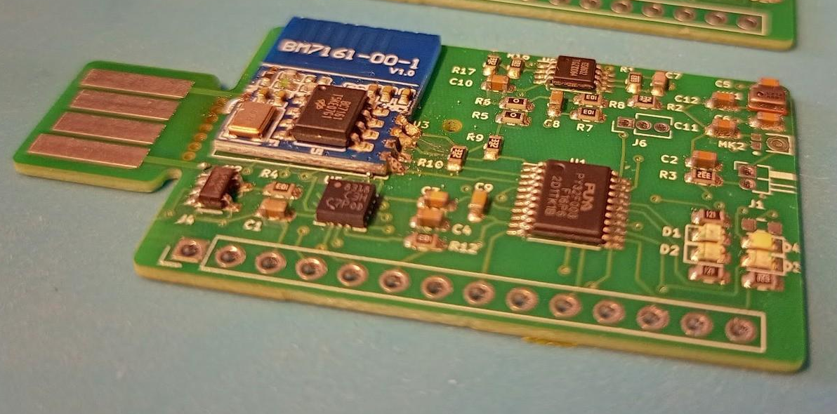
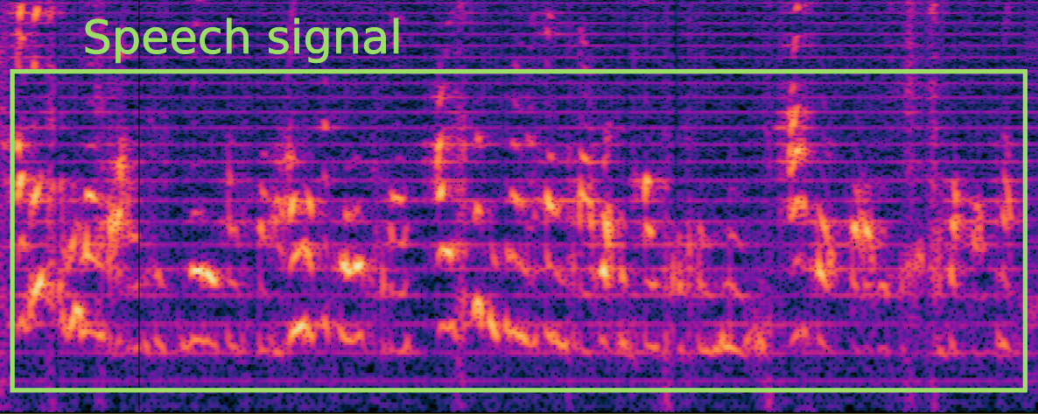
1 dollar TinyML
https://hackaday.io/project/194511-1-dollar-tinyml
Research question: Can we make a useful TinyML system <1 USD in total component cost (BOM)?
Preliminary answer: YES! Either motion (accelerometer) or sound sensor (microphone)
Constraints: 8 kB RAM / 64 kB FLASH
Current status: Audio streaming works Revision 2 ordered
A)
B)
Notes:
### Object detection

Slide 43

Sensor nodes
with MicroPython
and emlearn
https://github.com/ emlearn/emlearn-micropython

Slide 44
Task feasibility versus microcontroller type
 | RAM (kB) | FLASH (kB) | CPU (CoreMark) |  | IMU 100 hz 5 s | Sound 16 kHz 1 s | Image 64x64 px 1 fps
Arduino Uno ATMega 328 @ 16 Mhz | 2 | 32 | 4.0 |  | ✓ | ❌ | ❌
Arduino Nano BLE 33 NRF52840 ARM Cortex M4F @ 64 Mhz | 256 | 1 000 | 215 |  | ✓ | ✓ | ❌
Arduino Nano ESP32 ESP32-S3 @ 240 Mhz | 8 000 | 16 000 | 613 (per core) |  | ✓ | ✓ | ✓
Teensy 4.0 ARM Cortex M7 @ 600 Mhz | 1 000 | 2 000 | 2313 (per core) |  | ✓ | ✓ | ✓
Notes:
Coremark Mega 7.03 https://github.com/PaulStoffregen/CoreMark https://www.eembc.org/coremark/scores.php
Accelerometers/IMU 100-1kHz. Every N seconds. Human Activity Detection Basically anything ?
Sound
Typ 16 khz. Not 48 kHz
Specialized detectors. 1-100 classes
Image/video.
Low resolution, low framerate.
Specialized detectors. 1-10 classes. Not ImageNet Classification and object detection. Edge Impulse FOMO OpenMV
https://docs.edgeimpulse.com/docs/edge-impulse-studio/learning-blocks/object-detection/fomo-object-detection-for-constrained-devices

Slide 45
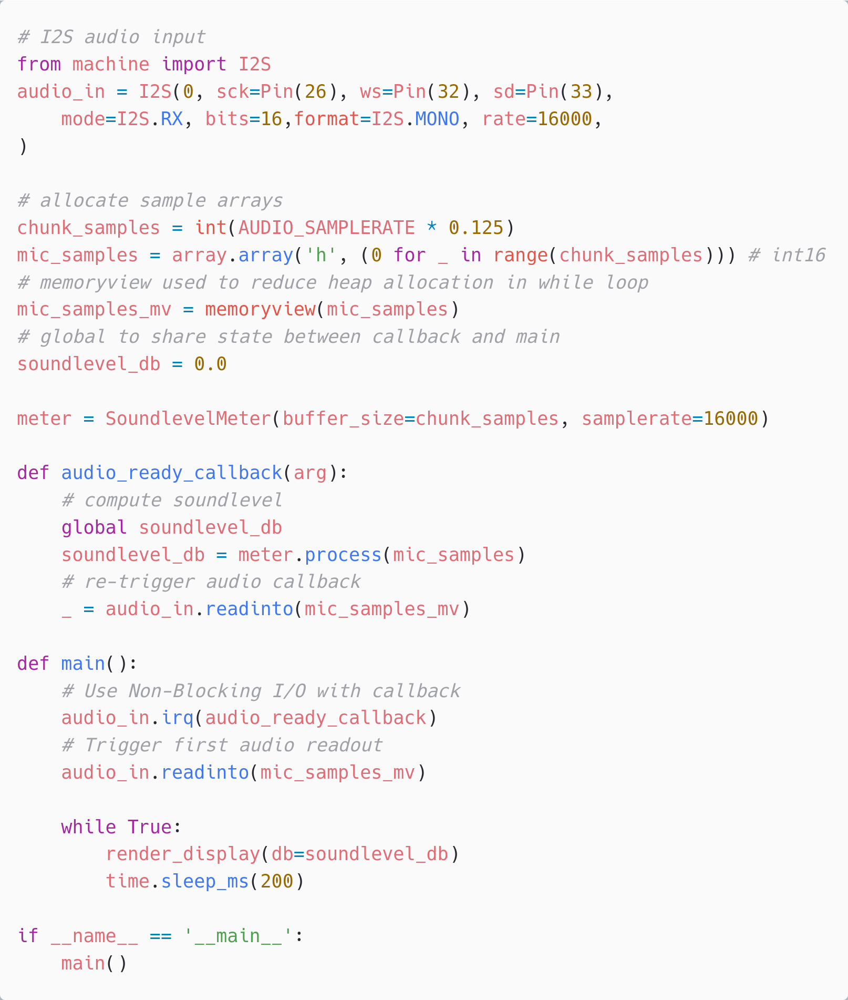
Audio input - machine.I2S
Digital microphone or external audio ADC
Can be done using I2S protocol
On ports ESP32, STM32, RP2, NRF52
PDM protocol not supported :(
Example code https://github.com/emlearn/emlearn-micropython/ tree/master/examples/soundlevel_iir https://github.com/miketeachman/micropython-i2s-examples

Slide 46
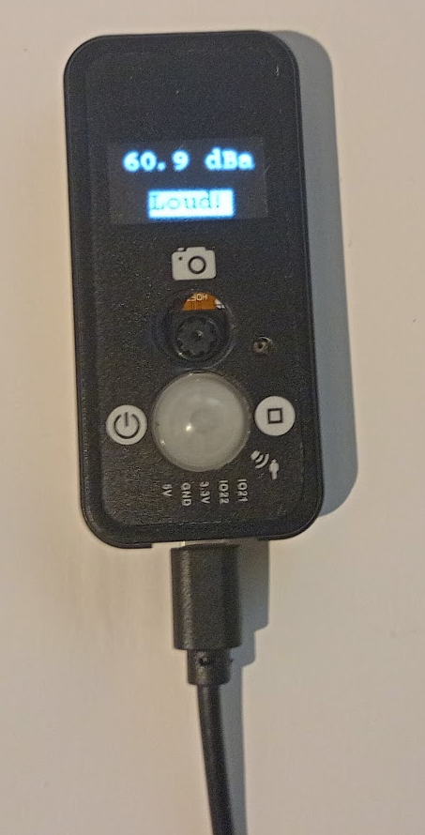
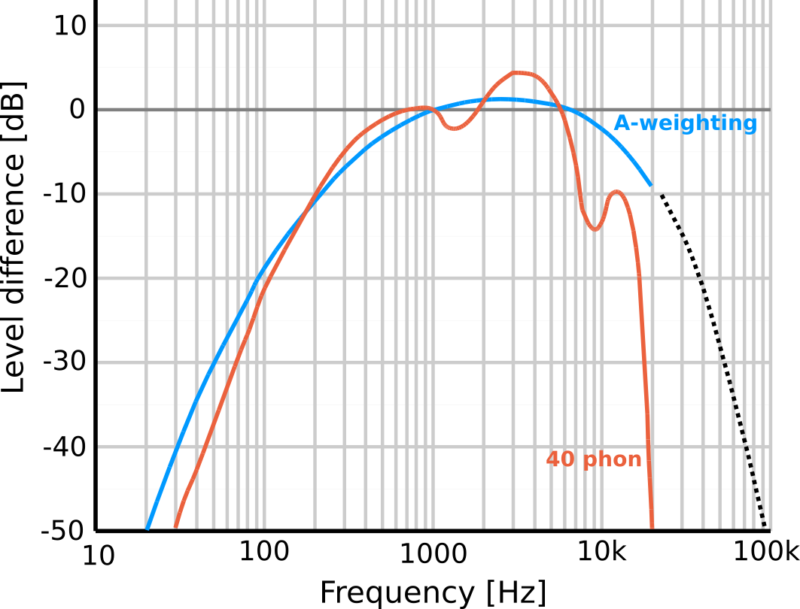
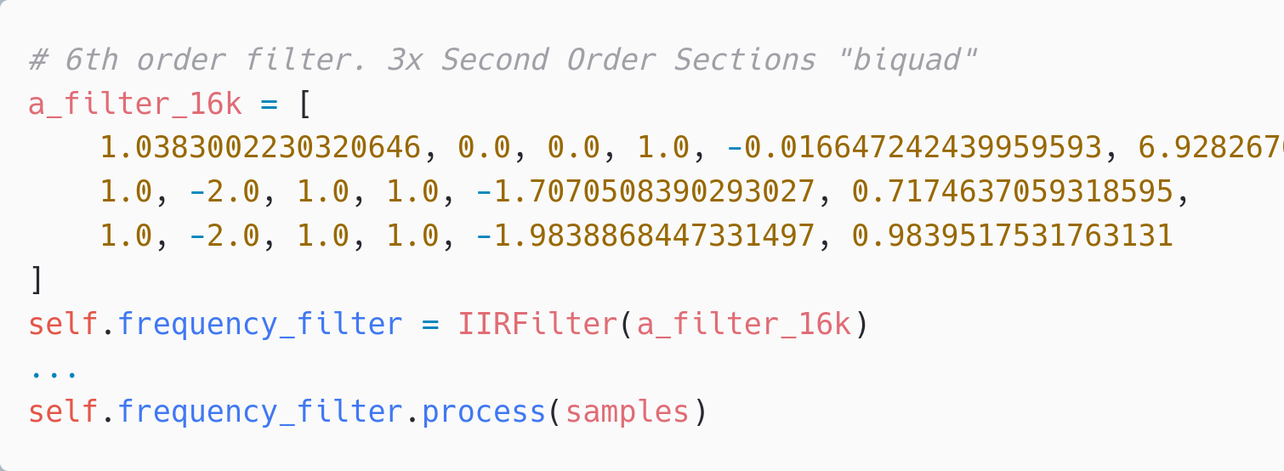
Noise sensor using emlearn_iir
Using machine.I2S 16 kHz samplerate
A weighting implemented with Infinite Impulse Response (IIR) filter emlearn_iir 25% CPU usage total pure MicroPython 900% CPU - not feasible
Complete example code https://github.com/emlearn/emlearn-micropython/ tree/master/examples/soundlevel_iir

Slide 47
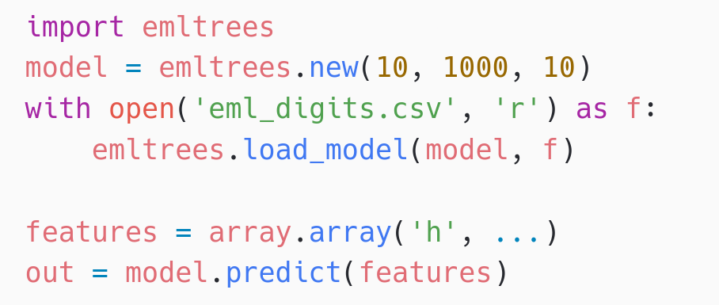
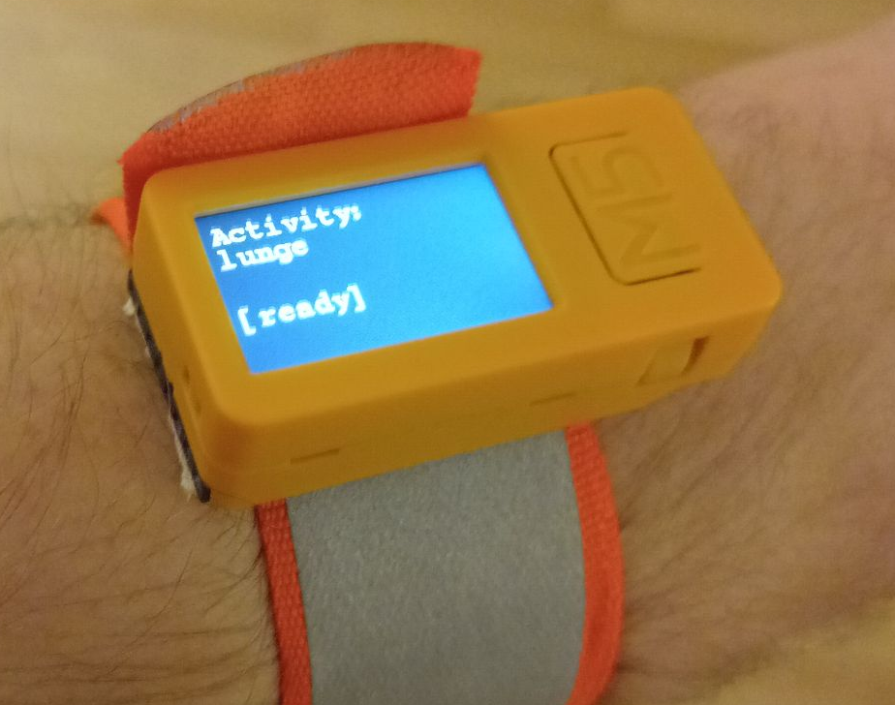
Human Activity Detection with emlearn_trees
Using Random Forest classifier trained with scikit-learn
Performance comparison
10 trees, max 100 leaf nodes, “digits” dataset
Inference time Program space
m2cgen 60.1 ms 179 kB everywhereml 17.7 ms 154 kB
emlearn 1.3 ms 15 kB
https://github.com/emlearn/emlearn-micropython /tree/master/examples/har_trees
emlearn is 10x faster and 10x more space efficient compared to generating Python code

Slide 48
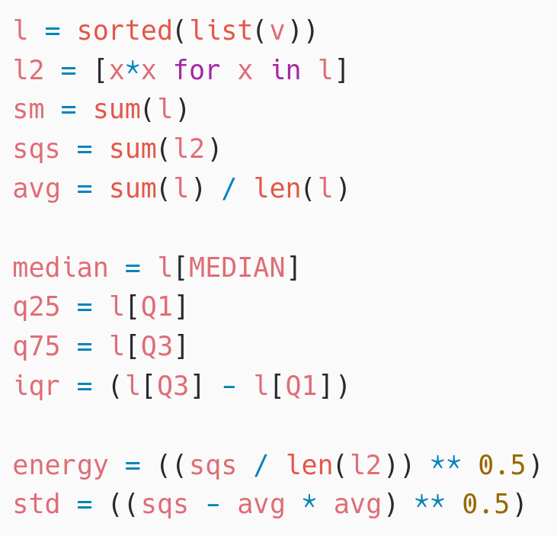
Activity Tracker - Feature Extraction
Statistical summarizations are useful time-series features, sufficient for basic Human Activity Recognition.
! Preprocessing must be compatible between training on host PC (CPython) and device (MicroPython)
Solution: Write preprocessor for MicroPython, re-use in Python
subprocess(‘micropython preprocess.py data.npy features.npy’)
Alternative: (when using common MicroPython/CPython subset)
import mypreprocessor.py
Using micropython-npyfile to read/write Numpy .npy files https://github.com/jonnor/micropython-npyfile/
https://github.com/emlearn/emlearn-micropython/blob/master/examples/har_trees/timebased.py
Time-based features extraction Are Microcontrollers Ready for Deep Learning-Based Human Activity Recognition?
Atis Elsts, and Ryan McConville
https://www.mdpi.com/2079-9292/10/21/2640

Slide 49
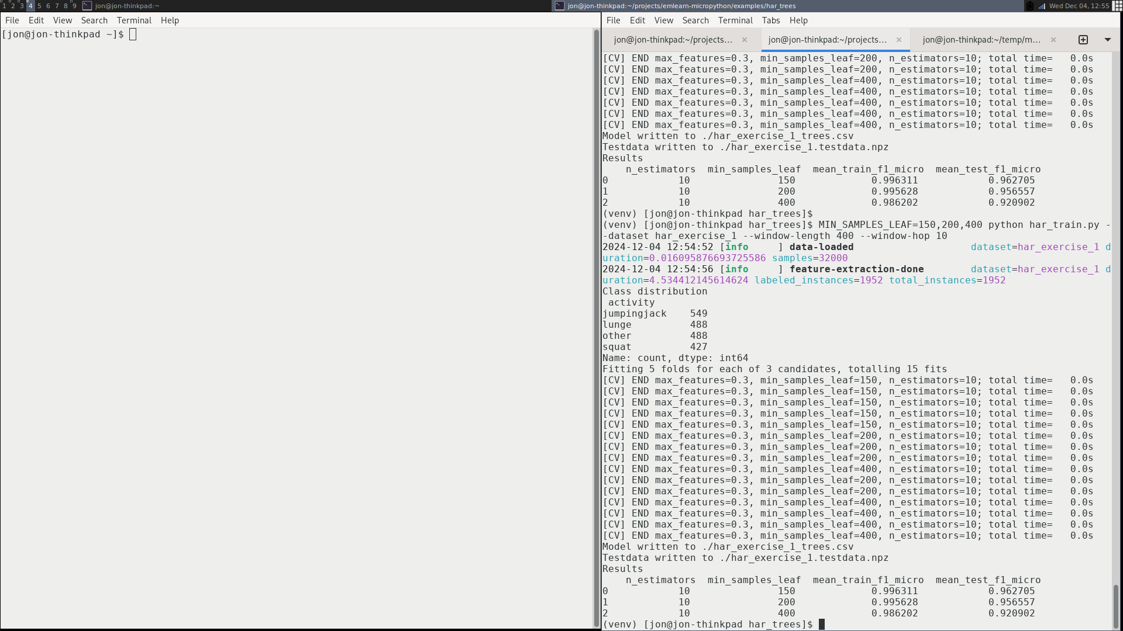
Training model on dataset
Using a scikit-learn based pipeline.
# Setup subject-based cross validation
splitter = GroupShuffleSplit(n_splits=n_splits, test_size=0.25,
random_state=random_state)
# Random Forest classifier
clf = RandomForestClassifier(random_state = random_state,
n_jobs=1, class_weight = "balanced")
# Hyper-parameter search
search = GridSearchCV(clf, param_grid=hyperparameters,
scoring=metric, refit=metric, cv=splitter)
search.fit(X, Y, groups=groups)
har_train.py
import emlearn
converted = emlearn.convert(clf)
converted.save(name='gesture', format=’csv’, file='model.csv')

Slide 50

Sound sensor - IIR filter
1100 ms 900% CPU
Native emitter
Float
Too slow by ~10x
Standard sound level measurements are A-weighted. To approximate human hearing.
Typically, implemented using Infinite Impulse Response (IIR) filters.

Slide 51


Sound sensor - IIR filter
IIR filter only Using emliir.mpy native module 30 ms 20% CPU - OK
Using emliir.mpy native module helps a lot.
BUT - conversion from float/int16 too slow Also needs a native module
But need to convert data types
Adds 70ms+ with micropython.native
Too slow! Total > 100 ms Must create native module
emliir.mpy from emlearm-micropython https://github.com/emlearn/emlearn-micropython/

Slide 52

Camera input
Not part of standard APIs yet
micropython-camera-API Proposed API and implementation (ESP32 only, for now)
https://github.com/ cnadler86/micropython-camera-API
OpenMV https://openmv.io/ Custom MicroPython distribution
Focused on Computer Vision / Machine Vision

Slide 53


Image classification with emlearn_cnn
Convolutional Neural Network (CNN)
Running on ESP32-S3 (example) Input dimensions: 32x32 px - 96x96 px Layers: 3 - 4 layers. Framerate: 1 - 10 FPS
Complete example code https://github.com/emlearn/emlearn-micropython/ tree/master/examples/mnist_cnn

Slide 54
Tree-based ensembles
Random Forest / Decision Tree
The most popular model in emlearn

Slide 55

emlearn trees: Leaf compression
scikit-learn decision trees store class probabilities in leaf-nodes. Size: n_leaves * n_classes * 4 bytes
Consequence: Leaves take a large amount of space
emlearn (since 2019) does hard majority voting instead
And does leaf-node de-duplication across all trees
Size: n_classes * 1 * 1 byte
Saving 50-80% of space
Tradeoff: May read to reduced predictive performance with some leaf values
0.0 | 1.0 | 0.0 | 0.0
1
Lossless
0.0 | 0.0 | 1.0 | 0.0
2
0.0 | 0.4 | 0.6 | 0.0
Not ideal
0.15 | 0.20 | 0.30 | 0.15
………
Notes:
Inline and loadable (data structure) Majority voting instead of class probabilities Leaf-node de-duplication

Slide 56
emlearn trees: Inference modes
Data structure (“loadable”)
Can be loaded at runtime
Only supports float
Code generation (“inline”)
Supports int8/int16/int32 and float
static const EmlTreesNode xor_model_nodes[14] = {
{ 1, 0.197349f, 1, 2 },
.........
{ 0, 0.421164f, -2, -1 }
};
EmlTrees xor_model = { 14, xor_model_nodes, …… };
static int32_t
eml_trees_predict_tree(const EmlTrees *f, int32_t tree_root,
const float *features, int8_t features_length) {
int32_t n = tree_root;
while (n >= 0) {
const float value = f[forest->nodes[node_idx].feature];
const float point = forest->nodes[node_idx].value;
const int16_t child = (value < point) ? f->nodes[n].left : f->nodes[n].right;
…..
}
return leaf;
}
static inline int32_t xor_model_tree_0(const float *features, int32_t features_length)
{
if (features[1] < 0.197349f) {
if (features[0] < 0.466316f) {
return 0;
} else {
return 1;
}
} else {
if (features[1] < 0.256702f) {
if (features[0] < 0.464752f) {
return 0;
} else {
return 1;
}
} else {
....
}
Notes:
16 bit integer features instead of 32 bit floats Reduced
Class probability leaves with clustering K-means

Slide 57


emlearn trees: K-means clustering for leaf de-duplication
Optimizing for: Small model size
Constraint: Under 1 percentage point drop in AUC ROC
Evaluating on 48 datasets from OpenML CC18 suite
Preliminary results - paper to follow
Hard majority sometimes bad:
Failed perf constraint on
75% of datasets
Clustering with N leaves per class Allows adaptable size/perf tradeoff
2-8 leaves per class sufficient 0% of datasets failed performance constraint
High model size compression 50-90%
Notes:
Inline and loadable (data structure) Majority voting instead of class probabilities Leaf-node de-duplication

Slide 58



Trees - relevant across the task complexity range
Low Go-to for tabular data
Very easy to get good performance, with minimal tweaking.
Medium Alternative to deep learning
Elsts et.al [1] showed performance matching a deep-learning approach,
at 10x to 100x better resource usage
High Combine with neural network Daghero et.al [2] showed up to 67.7% energy saving using two-stage approach
1. “Are Microcontrollers Ready for Deep Learning-Based Human Activity Recognition?” Atis Elsts, Ryan McConville (2021) https://www.mdpi.com/2079-9292/10/21/2640
2. “Two-stage Human Activity Recognition on Microcontrollers with Decision Trees and CNNs”. Francesco Daghero, Daniele Jahier Pagliari, Massimo Poncino (2022) https://arxiv.org/abs/2206.07652 3. “Energy Efficiency of Inference Algorithms for Clinical Laboratory Data Sets: Green Artificial Intelligence Study”
Jia-Ruei Yu et. al (2022) https://www.jmir.org/2022/1/e28036/
Notes:
The project was started in 2018 by me.
And has been maintained by me since that time. With a couple of contributors here and there. Quite mature. Has been used for dozens of projects across the world.

Slide 59
More MicroPython

Slide 60
TinyML for MicroPython - comparisons
Project | Deployment | Models | Program size | Compute time
emlearn | Easy. Native mod .mpy | DT, RF, KNN, CNN | Good | Good
everywhereml | Easy. Pure Python .py | DT, RF, SVM, KNN, | High with large models | Poor
m2cgen | Easy. Pure Python .py | DT, RF, SVM, KNN, MLP | High with large models | Poor
OpenMV.tf | Hard. Custom Fork | CNN | High initial size | Good
ulab | Hard. User C module | (build-your-own) Using ndarray primitives | High initial size | Unknown (assume good)
Notes:
Benchmark vs other MicroPython approaches

Slide 61
MicroPython is Python - but not CPython
High degree of compatibility - but never 100% Continuous job to keep up with CPython Some differences inherent - from < 1 MB RAM and FLASH Included libraries are minimal micropython-lib has more extensisive/featured https://github.com/micropython/micropython-lib
Known incompatibilities https://docs.micropython.org/en/latest/genrst/index.html #micropython-differences-from-cpython Not implemented (by CPython major release) https://github.com/micropython/micropython/issues/ 7919#issuecomment-1025221807
No CFFI or C module compatibility! But there is another C API
Garbage collected
One GC cycle will take 1-10 ms (typ) Some control, limited (gc module)
TLDR:
Will be very familiar to Python devs
Small scripts will mostly work with minor mods.
Larger programs/modules may need refactoring or rewrite to fit target
Notes:
Temperature is a slow changing phenomena. Want: 1 value for longish time interval (ex: 5 min)
! Sensor can be noisy. Filtering advised
Will show analog sensor example. Same approach can be used for a digital sensor. And for other slow-changing phenomena.

Slide 62

Hardware access - the machine module
https://docs.micropython.org/en/latest/library/machine.html
Hardware Abstraction Layer for microcontroller peripherals
Same on all hardware/ports * with exceptions
Notes:
Temperature is a slow changing phenomena. Want: 1 value for longish time interval (ex: 5 min)
! Sensor can be noisy. Filtering advised
Will show analog sensor example. Same approach can be used for a digital sensor. And for other slow-changing phenomena.

Slide 63
mip - package manager
Install from micropython-lib
mpremote install requests Third party packages
mpremote install github:jonnor/micropython-zipfile Can run directly on device *
import mip mip.install(‘requests’) * Assuming device has Internet over WiFi/Ethernet
Install native C modules at runtime
mpremote mip install https://example.net/ xtensawin_6.2*/emlearn_trees.mpy * Specify architecture + MicroPython ABI version
Notes:
Has support for loading C modules at runtime!

Slide 64

MicroPython for Embedded Linux

Slide 65
Motivation: Memory efficiency
CPython is quite RAM hungry. Especially “standard” Python/PyData ecosystem
scikit-learn with CPython: 13 - 128 MB from sklearn.ensemble import RandomForestClassifier estimator = RandomForestClassifier() # model not even trained yet!!! emlearn_trees with MicroPython: 0.1 - 6 MB 100 trees, 4000 nodes per tree (max_depth=12) import emlearn_trees model = emlearn_trees.new(100, 4000, 100)
MicroPython attractive for Linux devices with < 512 MB RAM

Slide 66
Unix MicroPyton port: Limited hardware access
Not implemented:
GPIO. machine.Pin / machine.PWM / machine.ADC
Digital busses. machine.I2C / SPI / USART / USB
Watchdog Timer. machine.WDT
Power management. machine.lightsleep() /deepsleep()
Audio input/microphone
Camera access
Need C or Python modules for this. Or call external programs.
Contributions welcome!
Already very useful for unit testing

Slide 67
Bridging the TinyML language gap
with MicroPython and emlearn
Jon Nordby jononor@gmail.com
March 2025, Nuremberg
https://github.com/emlearn/emlearn

